Slide 1
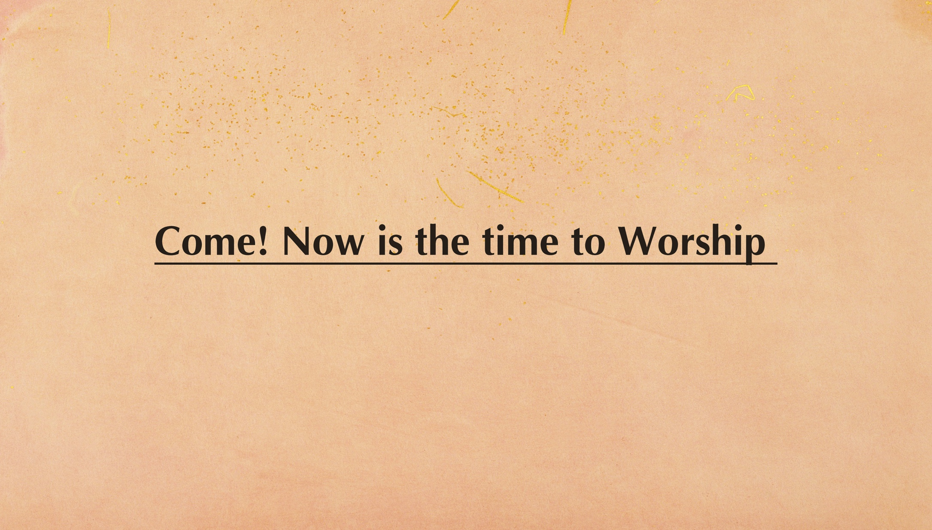


Slide 2

IN(4)

Slide 3
Come, now is the time to worship
Come, now is the time to give your heart
Come, just as you are to worship
Come, just as you are before your God
Come
Chorus

Slide 4
One day every tongue will confess You are God
One day every knee will bow
Still the greatest treasure remains for those
Who gladly choose You now
Verse

Slide 5
Come, now is the time to worship
Come, now is the time to give your heart
Come, just as you are to worship
Come, just as you are before your God
Come
Chorus

Slide 6
One day every tongue will confess You are God
One day every knee will bow
Still the greatest treasure remains for those
Who gladly choose You now
(x3)
Verse*3

Slide 7
Come, now is the time to worship
Come, now is the time to give your heart
Come, just as you are to worship
Come, just as you are before your God
Come
Chorus

Slide 9


Slide 10

Light of the world
You stepped down into darkness
Opened my eyes let me see
Beauty that made,This heart adore You
Hope of a life spent with You
神祢是光，祢照亮了黑暗，开我眼让我看见，
祢的荣美让我心渴慕祢，希望与祢不分离;
Verse 1

Slide 11
So here I am to worship
Here I am to bow down
Here I am to say that You're my God
And You're altogether lovely
Altogether worthy,Altogether wonderful to me
所以我在这里敬拜,屈膝向祢跪拜，大声宣告祢是我的神
哦，祢是如此美好，祢是如此配得，我在这里敬拜祢圣名，
Chorus

Slide 12
King of all days,Oh so highly exalted
Glorious in heaven above
Humbly You came
To the earth You created
All for love's sake became poor
万王之王，坐在至高宝座上，散发荣耀的光芒，
谦卑自己来到祢所造之地，为了爱牺牲自己;
Verse 2

Slide 13
So here I am to worship
Here I am to bow down
Here I am to say that You're my God
And You're altogether lovely
Altogether worthy,Altogether wonderful to me
所以我在这里敬拜,屈膝向祢跪拜，大声宣告祢是我的神
哦，祢是如此美好，祢是如此配得，我在这里敬拜祢圣名，
Chorus

Slide 14
And I'll never know how much it cost
To see my sin upon that cross
And I'll never know how much it cost
To see my sin upon that cross
（x4）
我不知道多少代价能使我罪钉上十架
Bridge*4

Slide 15
So here I am to worship
Here I am to bow down
Here I am to say that You're my God
And You're altogether lovely
Altogether worthy,Altogether wonderful to me
所以我在这里敬拜,屈膝向祢跪拜，大声宣告祢是我的神
哦，祢是如此美好，祢是如此配得，我在这里敬拜祢圣名，
Chorus -- end

Slide 17


Slide 18

再没有事物 能与你相比
活泼的盼望 超越全世界 你同在里
zai mei you shi wu neng yu ni Xiang bi
huo po de pan wang chao yue quan shi jie Ni tong zai li
Verse 1

Slide 19
我尝到世上 最甜美的爱 当我心得释放
我羞愧都松开 你同在里
Wo chang dao shi shang zui tian mei de ai
Dang wo xin de shi fang Wo xiu kui dou song kai
Ni tong zai li
Verse 2

Slide 20
亲爱圣灵 我们欢迎你
充满这氛围 浇灌在这地
qin ai sheng ling wo men huan ying ni
chong man zhe fen wei jiao guan zai zhe di
Chorus-1

Slide 21
我全心渴慕 你荣耀降临
完全降服于 你的同在里 你同在里
wo quan xin ke mu ni rong yao jiang lin
wan quan xiang fu yu ni de tong zai li
Chorus-2

Slide 22
再没有事物 能与你相比
活泼的盼望 超越全世界 你同在里
zai mei you shi wu neng yu ni Xiang bi
huo po de pan wang chao yue quan shi jie Ni tong zai li
Verse 1

Slide 23
我尝到世上 最甜美的爱 当我心得释放
我羞愧都松开 你同在里
Wo chang dao shi shang zui tian mei de ai
Dang wo xin de shi fang Wo xiu kui dou song kai
Ni tong zai li
Verse 2

Slide 24
亲爱圣灵 我们欢迎你
充满这氛围 浇灌在这地
qin ai sheng ling wo men huan ying ni
chong man zhe fen wei jiao guan zai zhe di
Chorus-1

Slide 25
我全心渴慕 你荣耀降临
完全降服于 你的同在里 你同在里
wo quan xin ke mu ni rong yao jiang lin
wan quan xiang fu yu ni de tong zai li
Chorus-2

Slide 26
亲爱圣灵 我们欢迎你
充满这氛围 浇灌在这地
qin ai sheng ling wo men huan ying ni
chong man zhe fen wei jiao guan zai zhe di
Chorus-1

Slide 27
我全心渴慕 你荣耀降临
完全降服于 你的同在里 你同在里
wo quan xin ke mu ni rong yao jiang lin
wan quan xiang fu yu ni de tong zai li
Chorus-2

Slide 28
In 10

Slide 29
让我更多 来感受 你的同在
让我更多经历你荣耀中的良善
(x4)
rang wo geng duo lai gan shou ni de tong zai
rang wo geng duo jing li ni rong yao zhong de liang shan
Bridge*4

Slide 30
亲爱圣灵 我们欢迎你
充满这氛围 浇灌在这地
qin ai sheng ling wo men huan ying ni
chong man zhe fen wei jiao guan zai zhe di
Chorus-1

Slide 31
我全心渴慕 你荣耀降临
完全降服于 你的同在里 你同在里
wo quan xin ke mu ni rong yao jiang lin
wan quan xiang fu yu ni de tong zai li
Chorus-2-end

Slide 33

Inter(4)

Slide 34

Inter(4)

Slide 35
耶稣 我要爱慕祢
我要爱慕祢 倾倒我的生命
祢是我唯一所求 让我心单单渴慕祢
ye su wo yao ai mu ni
wo yao ai mu ni qing dao wo de sheng ming
ni shi wo wei yi suo qiu rang wo xin dan dan ke mu ni
Verse 1

Slide 36
耶稣 我要爱慕祢
我要爱慕祢 倾倒我的生命
祢是我唯一所求 让我心单单渴慕祢
ye su wo yao ai mu ni
wo yao ai mu ni qing dao wo de sheng ming
ni shi wo wei yi suo qiu rang wo xin dan dan ke mu ni
Verse 2

Slide 37
我心满溢 我心满溢
对祢的爱和思念无止尽
wo xin man yi wo xin man yi
dui ni de ai he si nian wu zhi jin
chorus -1

Slide 38
让我走向 祢的身旁 贴近祢
主啊 我渴慕寻求祢
rang wo zou xiang ni de shen pang tie jin ni
zhu a wo ke mu xun qiu ni
chorus -2

Slide 39
耶稣 我要爱慕祢
我要爱慕祢 倾倒我的生命
祢是我唯一所求 让我心单单渴慕祢
ye su wo yao ai mu ni
wo yao ai mu ni qing dao wo de sheng ming
ni shi wo wei yi suo qiu rang wo xin dan dan ke mu ni
Verse 1

Slide 40
耶稣 我要爱慕祢
我要爱慕祢 倾倒我的生命
祢是我唯一所求 让我心单单渴慕祢
ye su wo yao ai mu ni
wo yao ai mu ni qing dao wo de sheng ming
ni shi wo wei yi suo qiu rang wo xin dan dan ke mu ni
Verse 2

Slide 41
我心满溢 我心满溢
对祢的爱和思念无止尽
wo xin man yi wo xin man yi
dui ni de ai he si nian wu zhi jin
chorus -1

Slide 42
让我走向 祢的身旁 贴近祢
主啊 我渴慕寻求祢
rang wo zou xiang ni de shen pang tie jin ni
zhu a wo ke mu xun qiu ni
chorus -2

Slide 43
我心满溢 我心满溢
对祢的爱和思念无止尽
wo xin man yi wo xin man yi
dui ni de ai he si nian wu zhi jin
chorus -1

Slide 44
让我走向 祢的身旁 贴近祢
主啊 我渴慕寻求祢
rang wo zou xiang ni de shen pang tie jin ni
zhu a wo ke mu xun qiu ni
chorus -2

Slide 45
我心满溢 我心满溢
对祢的爱和思念无止尽
wo xin man yi wo xin man yi
dui ni de ai he si nian wu zhi jin
chorus -1

Slide 46
让我走向 祢的身旁 贴近祢
主啊 我渴慕寻求祢
rang wo zou xiang ni de shen pang tie jin ni
zhu a wo ke mu xun qiu ni
chorus -2 - end

Slide 47
Inter(4)

